Slide 1



New Light
VICTIM, BRAVE, WOMEN

Slide 2

About our project
We are aiming towards a project based on women's who are victims of rape in our country through our website.

Slide 3

Problems :
Girls hesitate to talk freely about what they have suffered.
There is no one to support and give them a new ray of hope.
The society also blames the girls.
It affects their physical and social wellbeing.
Some also attempts to suicide due to the above raised problems.

Slide 4
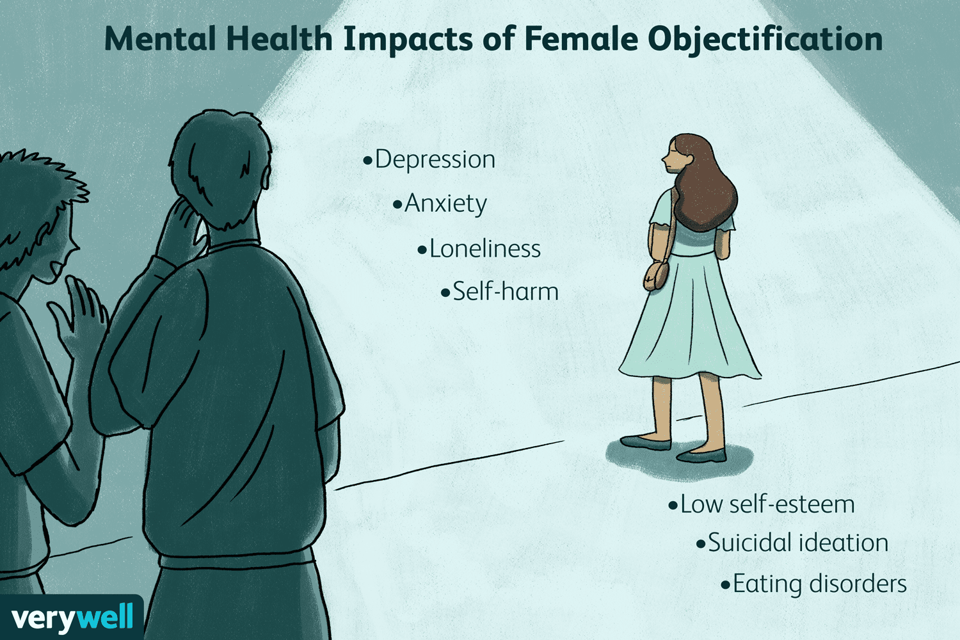

Slide 5
Solutions we’re providing :
Where they can share their circumstances with those who had suffered it already and also overcome it.
Content related to motivational videos, self defence training to all girls, TedTalks.
Made them aware about their laws & rights.
Proper counselling sessions along with full NGO’s support in every kind.

Slide 6

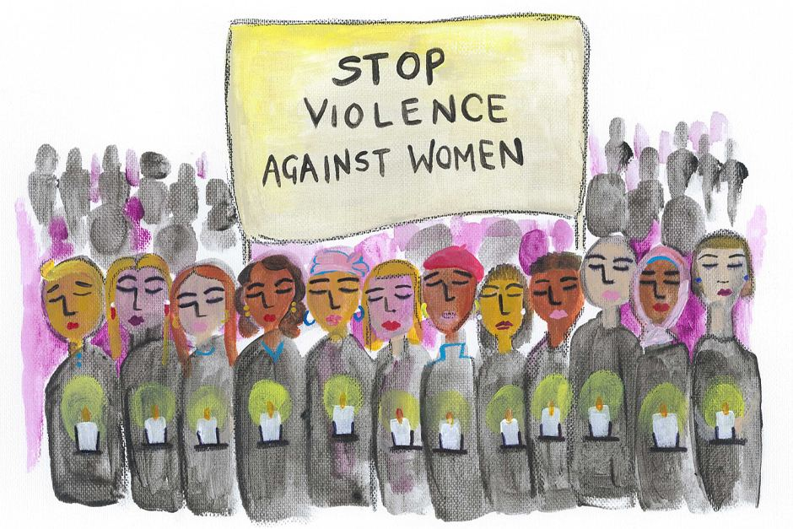
We will also work on our new light app.
We will be including SOS button for the safety of women.

Slide 7
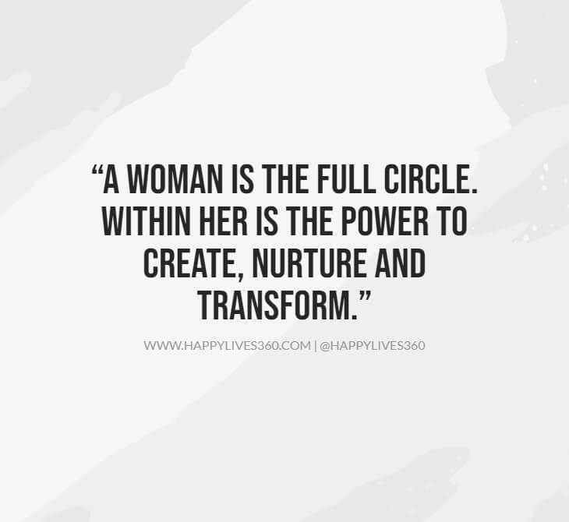
Created by: Team : tantalizing techez
Uday garg
Armandeep singh
Shivam Bhardwaj
Navpreet singh

